Slide 1
Granite State Taxpayers 2024 Summer Meeting
Protecting the New Hampshire Advantage
With Governor Christopher T. Sununu
Agenda
Opening Remarks Ray Chadwick
GST 2023-2024 Scorecards Dan McGuire
Introduce Gov. Sununu Ray Chadwick
Gov. Sununu Remarks
Q & A
Adjourn

Slide 2
Granite State Taxpayers 2024 Summer Meeting
After the 2018 election Democrats controlled the NH House, Senate and Executive Council.
They passed a sales tax
They passed a capital gains tax
They passed a Family Medical Leave plan to be administered by the State, and paid for by premium deductions (aka: taxing) employee personal income
And various other initiatives that were counter to a conservative agenda

Slide 3
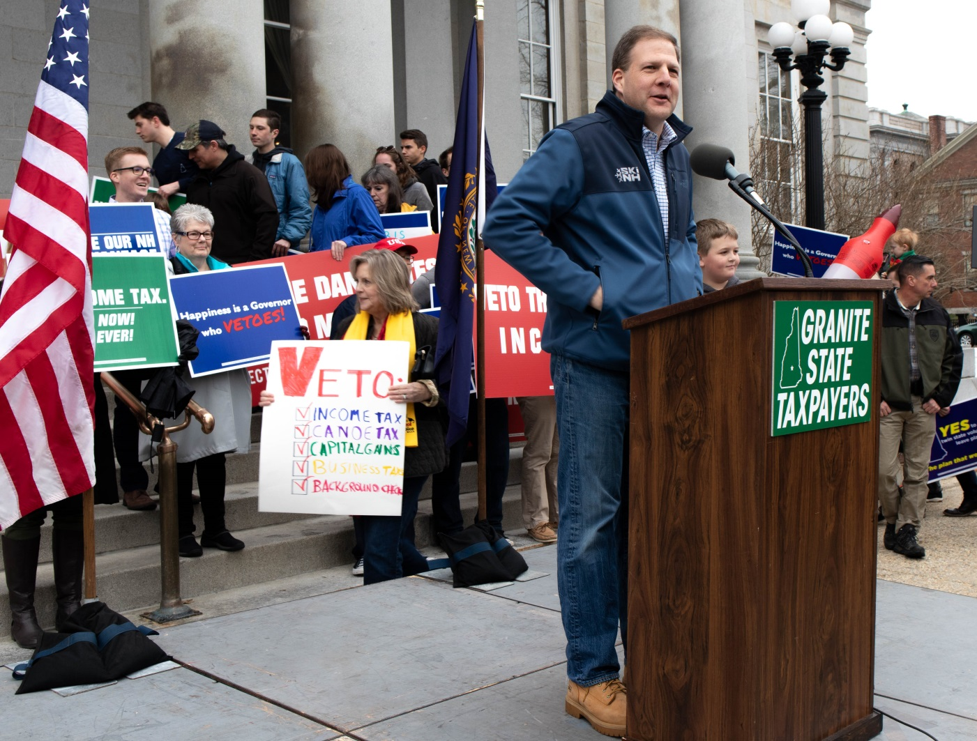
Granite State Taxpayers 2024 Summer Meeting
The GST Protect the New Hampshire Rally March 30, 2019.
https://granitestatetaxpayers.org/gst/preserve-the-nh-advantage-rally/

Slide 4
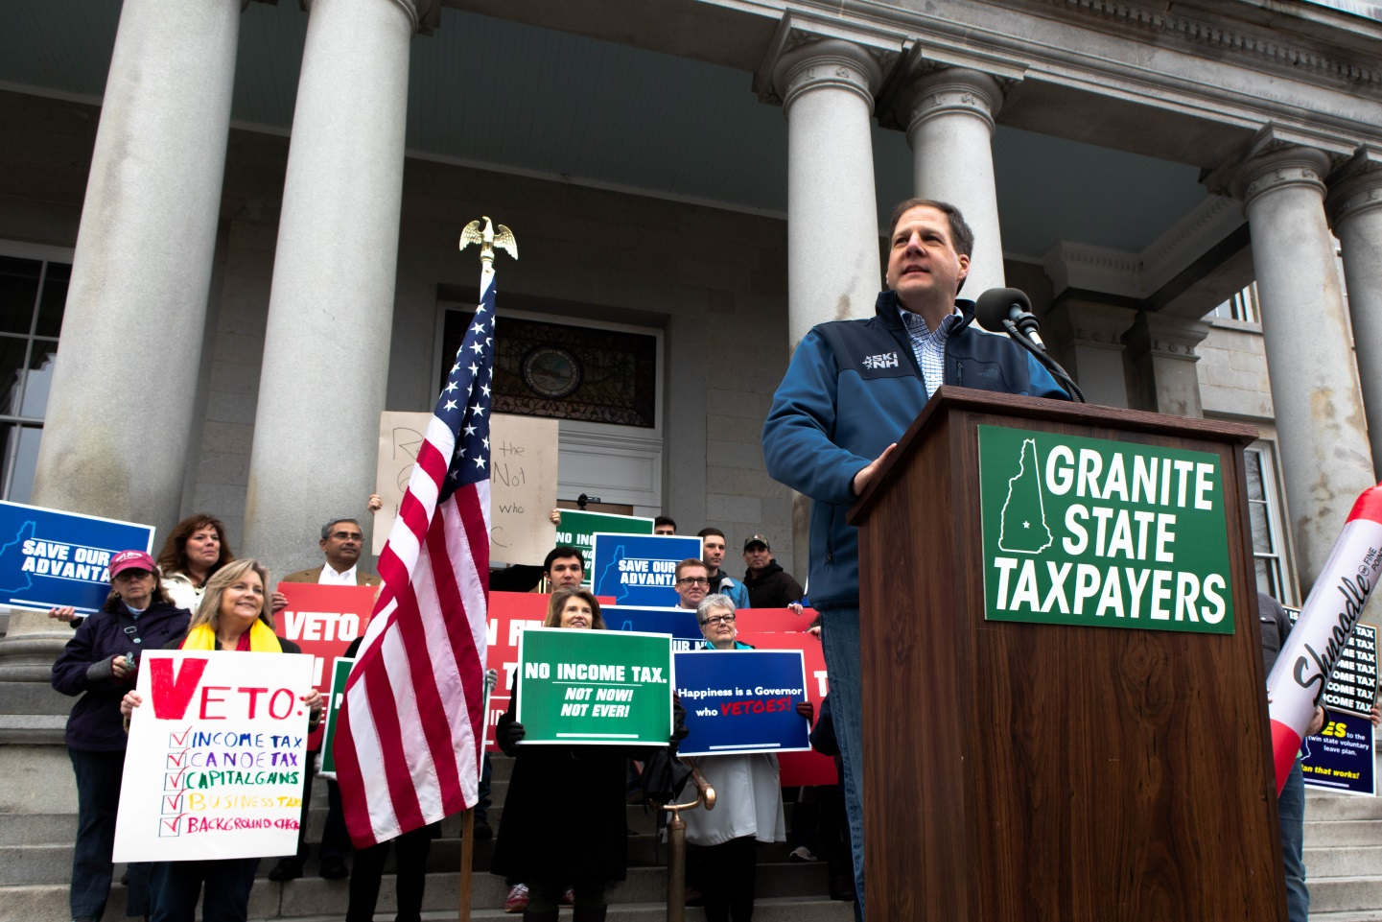
Granite State Taxpayers 2024 Summer Meeting
Governor Sununu vowed to use his Veto Power to Preserve
the New Hampshire Advantage.
Video at: https://www.youtube.com/watch?v=jFy0tJ5rLDE.

Slide 5
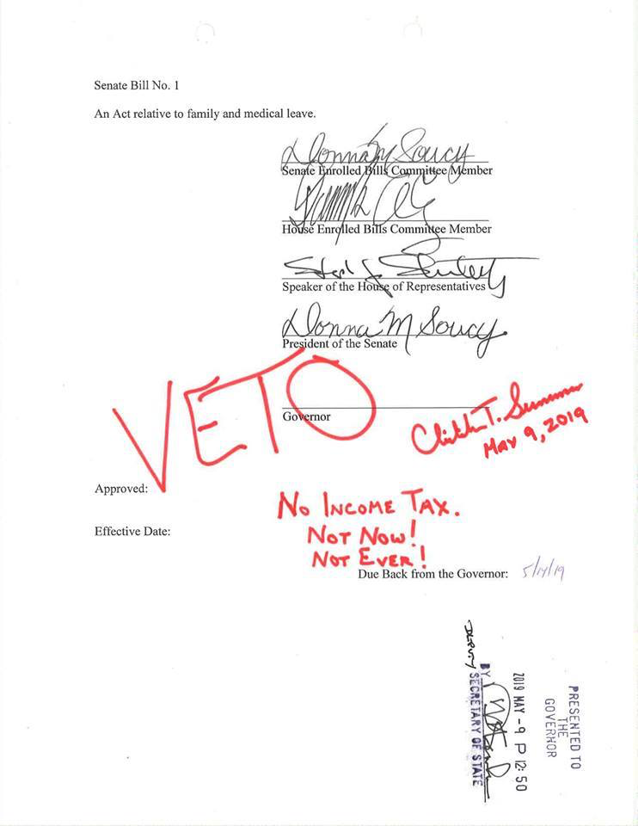
Granite State Taxpayers 2024 Summer Meeting
Veto of Family Medical Leave Plan May 9, 2019.

Slide 6
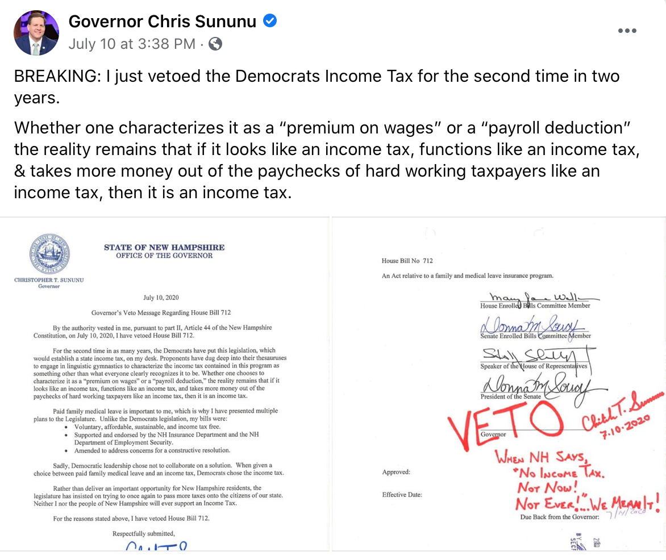
Granite State Taxpayers 2024 Summer Meeting
Second Veto of Family Medical Leave Plan July 10, 2020.

Slide 7
Granite State Taxpayers 2024 Summer Meeting
Results in New Hampshire of 2 years (2021 – 2022) of Republican control of Government:
Thriving economy that produced $430 million more in surplus than what was budgeted
Increased the Rainy Day fund to about $250 million
A budget that was $172 million less than the previous budget
Reduced tax rates on business, interest and dividends, rooms and meals and property.
Increased transfers of funds to the towns and cities for property tax relief.
Wikipedia: NH had the lowest poverty rate in the nation and 8th highest for median household income
NH’s unemployment rate was 3rd lowest nationally at 2.3%
Cato Institute ranked NH #1 overall, #2 in Personal Freedom, #3 in both Fiscal and Economic Freedom
The Tax Foundation rated our business climate as 6th best nationally, and our state and local tax burden as #16. The next closest state in New England was Rhode Island at #36
WalletHub ranked the NH’s economy as the 5th best nationally

Slide 8
Granite State Taxpayers 2024 Summer Meeting
Chris Sununu has been Governor through 8 years of momentous change.
Tax policy, EFAs, pandemic, the Biden administration, energy costs, and more.
Hear why New Hampshire remains a beacon of sanity in New England.

