Slide 1
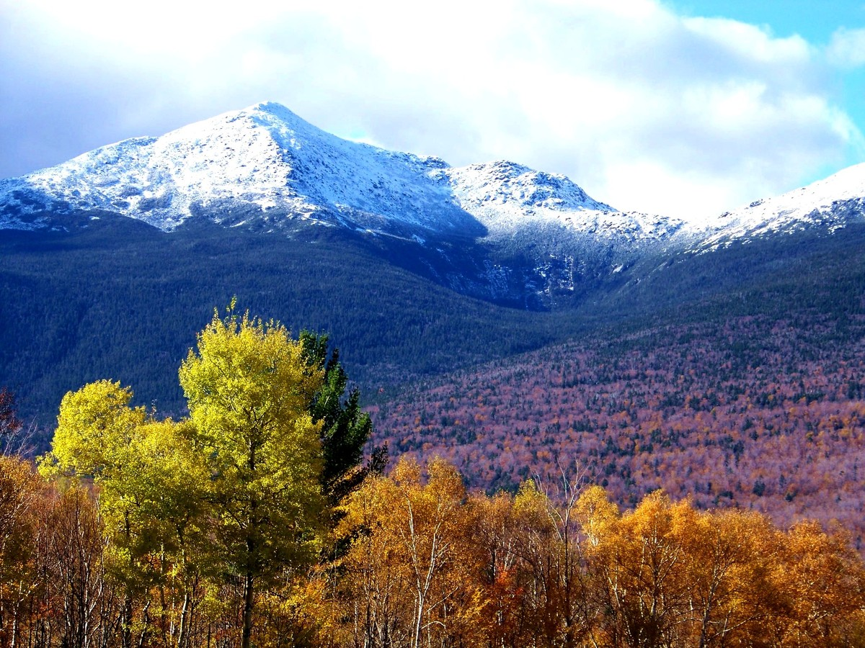
The Folly of The Green New Deal
Thoughts on the Paris Accord

Slide 2
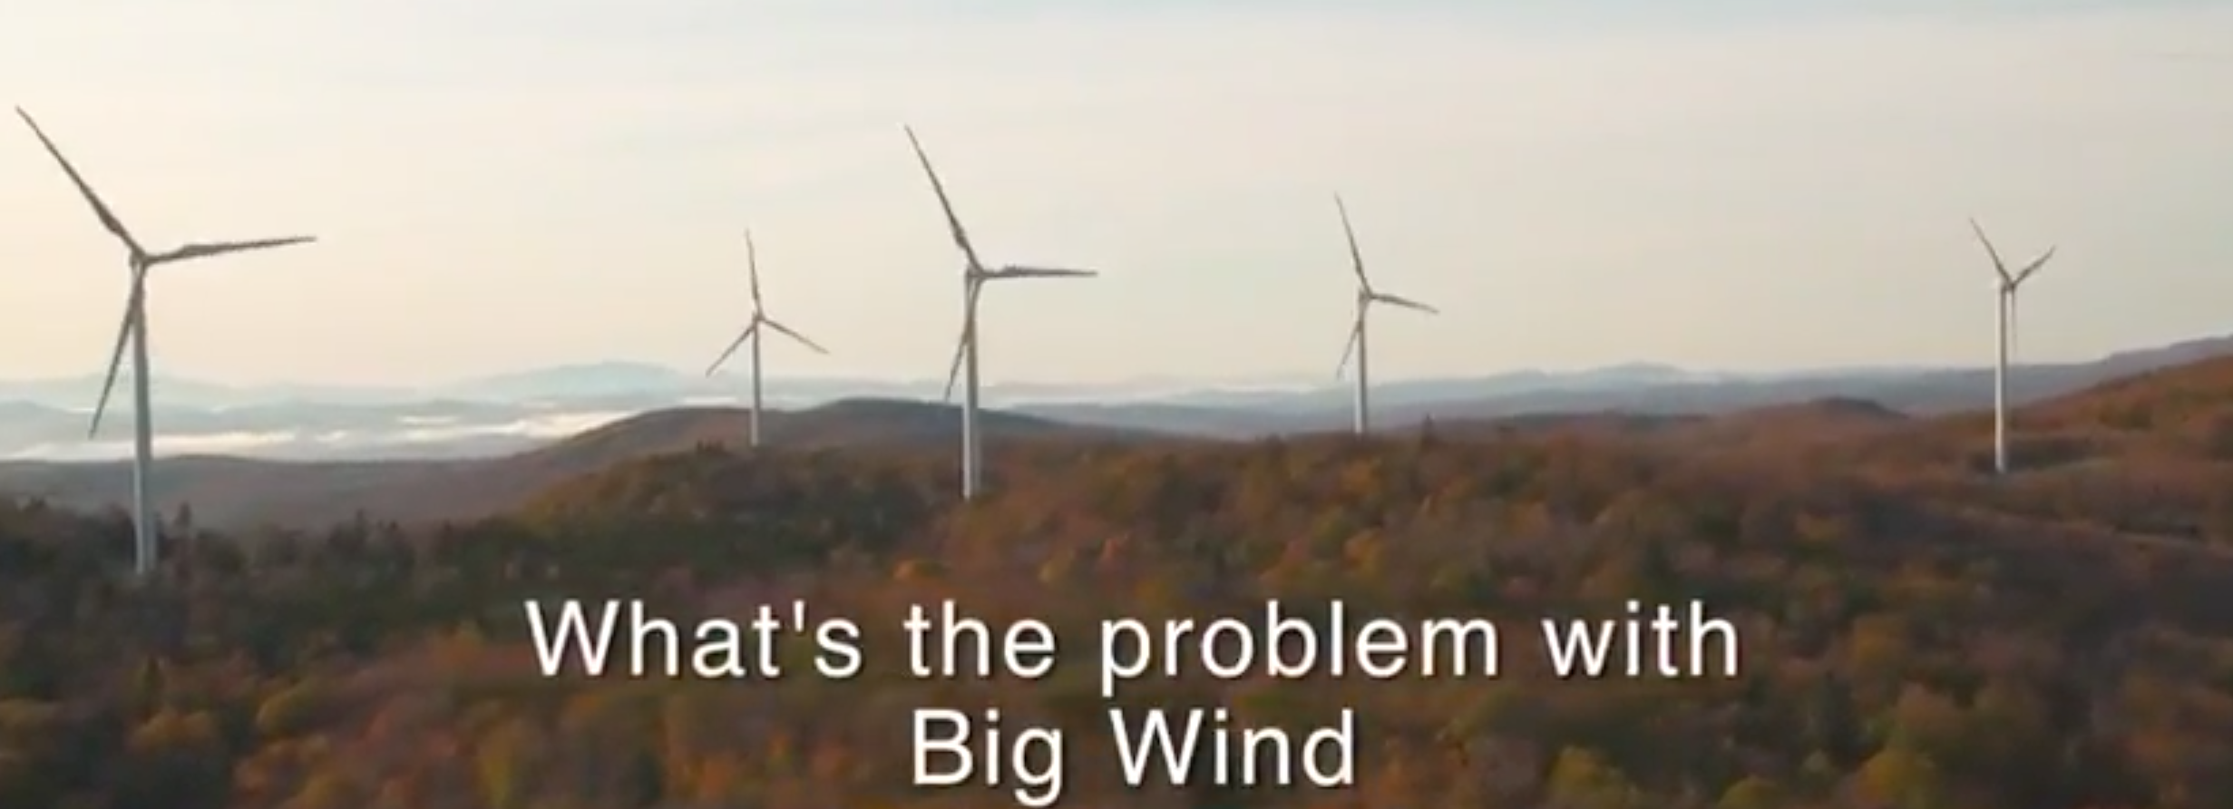

Slide 3
https://youtu.be/VAhAxyDRFs8
First 3:30 of this…then cut to 4:35

Slide 4
Wind Power Issues
Vulnerability to ice storms, common in the northeast and south
Lightning and hurricane force high mountain winds
Wind turbines have serious health effects
Wind turbines will negatively affect tourism, our #2 industry
Wind turbines devalue property
Wind turbines affect weather radar and aviation providing false alarms
Wind has proven to be undependable, often not there when needed the most during extreme cold and heat. Inefficient back up energy increases costs and CO2 production over more efficient natural gas plants without wind
Wind would drive up the cost of energy dramatically as it did in Europe, hurting the poor and elderly on fixed incomes
To limit costs, wind farms are poorly maintained and have shortened lifetimes, with no budget for replacement/repair
Rising costs of energy is bad for the economy driving jobs away. In Europe this has caused Spain, Germany and the UK to stop subsidies as prices and unemployment skyrocketed

Slide 5
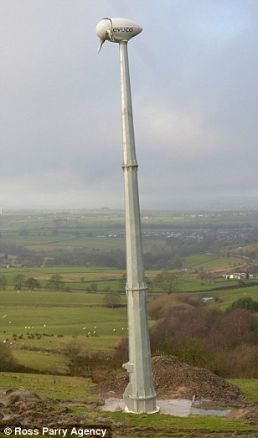
Mt Washington Study
FAQ: Why Doesn’t the Observatory use Wind Power?
Several years ago a lengthy study was conducted on Mt Washington evaluating the potential to harness wind power. The study concluded that the frequent icing of equipment and the strength and gustiness of the wind at this location was so severe that wind energy would not be a practical or cost effective alternative.
  Fires and blade damage from lighting strikes and extreme winds, are a much higher probability at higher elevations
    Mt Washington averages 16 thunderstorm days per year. A lightning strike on an unprotected blade can lead to temperature increases of up to 30,000 degrees Celsius, and result in an explosive expansion of the air within the blades
    Mt Washington frequently gets winds exceeding hurricane force, wind gusts have reached 231 mph.
Scotland wind damage

Slide 6
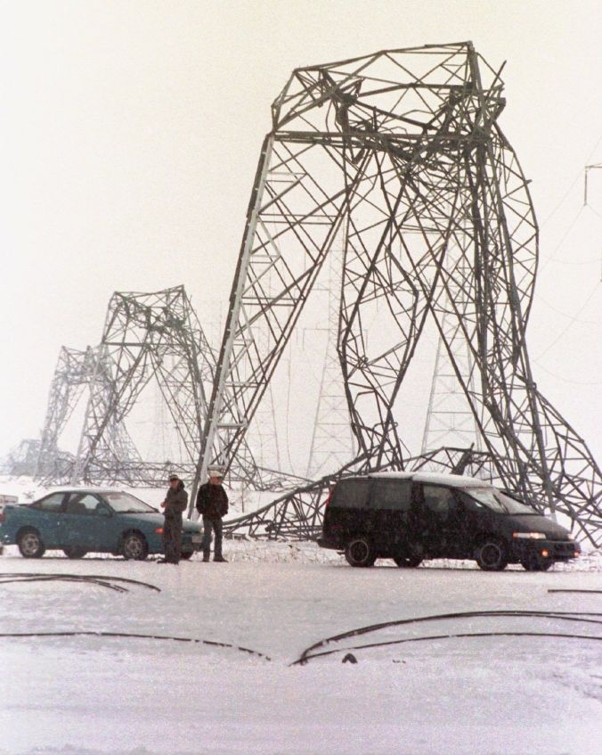
Icing and Ice Storms
Major ice storms occur on average every 7 years in the northeast. Ice damage can be very severe to power lines and power poles and turbines.
  The devastating 1998 ice storm in northern New England and Quebec brought as much as 8.2 inches of ice, left 300,000 people shivering in the dark for a month. Thirty people died in Canada and another 17 in the United States.
  The storm of 2008 left as many as 1.7 million NH customers without power.
Heavy ice could lead to major damage to and even the collapse of wind turbines. In Canada’s 1998 ice storm, heavy duty towers collapsed under the weight of ice.

Slide 7
Health Impacts
In Canada, Carmen Krogh, a retired Alberta pharmacist and a group of volunteers surveyed residents in areas near wind farms. Of 76 people who responded to their informal survey, 53 reported at least one health complaint.
All across the US, lawsuits have been filed against the wind farms because of these health issues. In Massachusetts, a judge recently ruled that a utility company had to dramatically scale back its operating hours because homeowners were suffering, “irreparable physical and psychological harm.” Falmouth has become ground zero for poorly placed wind turbines in the United States. Up to 200 residents in Falmouth, MA are reporting health issues allegedly caused by their town's wind turbines
An epidemiology study conducted by World Health Organization demonstrated sleep disturbance by noise increased 40% and the the risk of depression 100% from the impacts of wind turbines.
  Sleep disturbances can affect your immune system. Studies show that people who don't get quality sleep or enough sleep are more likely to get sick. Lack of sleep can also affect how fast you recover if you do get sick.
  Lack of sleep and depression can affect performance at work and school.

Slide 8
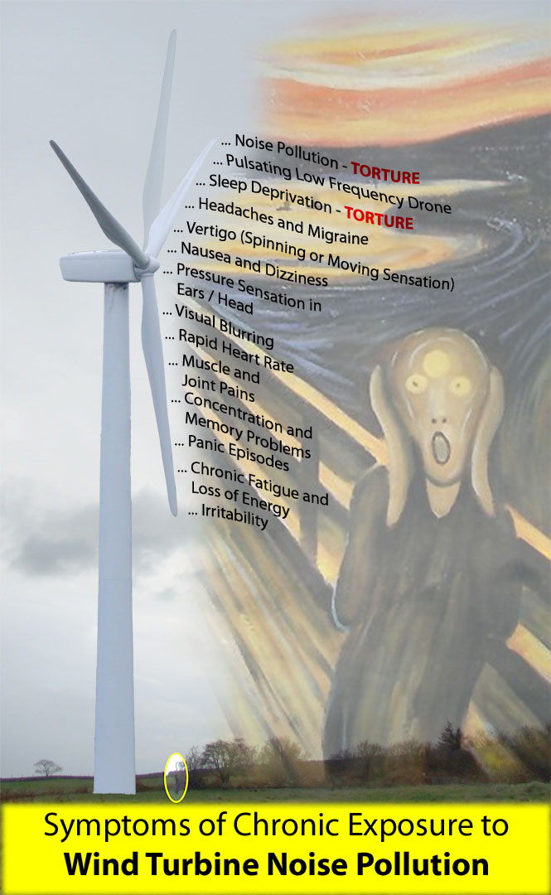
Communities in Germany, Wales, and Ireland claim that 3,000 feet away the noise is significant.
The noise of a wind plant in Ireland was measured in 2002 near 4000 feet upwind.
A German study in 2003 found significant noise levels 1 mile away from a 2-year-old wind farm of 17 turbines, especially at night.
In mountainous areas the sound echoes over larger distances. A neighbor of the 20-turbine Meyersdale facility in Pennsylvania found the noise level at his house, about a half mile away, to average 75 dB(A) over a 48-hour period, well above the level that the EPA says prevents sleep.
In Vermont, the director of Energy Efficiency for the Department of Public Service, Rob Ide, has said that the noise from the 11 Searsburg turbines is significant a mile away. Residents 1.5 and even 3 miles downwind in otherwise quiet rural areas suffer significant noise pollution.

Slide 9
Tourism
Tourism is New Hampshire’s second-largest industry. The Outdoor Foundation reports tourism supports 53,000 jobs, generates $261 million in annual state tax revenue and produces nearly $4 billion annually in retail sales and services.
State parks benefit tourism . A recent survey the Division of Travel and Tourism found “… 70% agreed that New Hampshire has great state and national parks…and the natural beauty of our quintessential New England landscape”. -Lori Harnois, Director, NH Division of Travel and Tourism Development
Plans to dot France with wind farms faced fierce opposition from critics worried they will blight a landscape that has helped make the country the world’s top tourist destination. ...opponents are urging the government to tread carefully so as not to damage France’s thousands of kilometers of stunningly beautiful landscapes.
New Hampshire should do likewise!!!

Slide 10
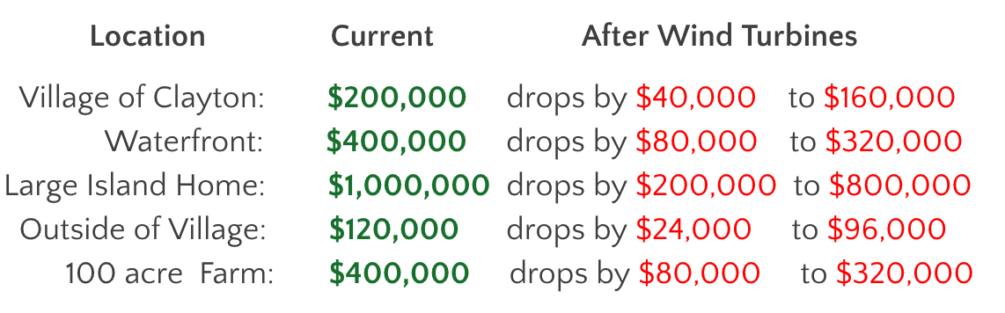
Property Devaluation
Though proponents of wind pay well for university studies that say wind turbines enhance property value, there is concrete evidence to the contrary.
In a wind impact study in Dodge and Fond Du Lac Counties, Wisconsin, large turbines (389 feet high), an opinion survey of realtors and sales studies determined that sales were less than outside the areas, and prices were lower. Land values were decreased from 13% to 47% with an average of 30%.
Near Watertown, New York, for the Horse Creek project:

Slide 11
Bird/Bat Kill
According to an estimate published in the Wildlife Society Bulletin in March, almost 600,000 birds are killed by wind farms in America each year, including over 80,000 raptors such as hawks and falcons and eagles. Endangered and protected species are included.
The Obama administration gave the wind industry a pass on bird kill. In its own documents supporting the rule, the US Department of the Interior states: "large soaring birds, specifically raptors, are especially vulnerable to colliding with wind turbines (Barrios and Rodriguez 2004, Kuvlesky et al. 2007)." It also states that it does not know how to solve that problem.
In New Hampshire winter is peak viewing time for bald eagles along the Merrimack, if they don't fly into the state's ever-growing number of windmills first. A Union Leader editorial wonders how many will be left 30 years from now if windmills keep popping up along New Hampshire's ridgelines
Quietly, bats die, as their lungs are inverted by the negative pressures generated behind the 170 mile-per-hour spinning blades. A study from the University of Colorado, estimates that 600,000 bats were killed by wind turbines last year alone – could be as high as 900,000. Bats feed on insects that would otherwise destroy crops, and it pollinates as it goes about its nightly tasks.

Slide 12
Wind is Undependable
When you need it most, wind is often not available or at best intermittent, requiring ready back up fossil fuel sources running in inefficient modes.
  Strongest winds at wind turbine levels are at night when energy demand is less.
  Frigid arctic air masses often cause winds to go calm.
    In 2009, Black Bear Lake in Maine reached a state all-time record low of -50F with calm winds.
    In December 2010, when the UK had the second coldest December since the Little Ice Age in 1659, wind produced less than 0.5% of energy needs (when 20% was promised)
    The same wind power die down in west Texas was observed in a cold outbreak causing brownouts in Dallas and Houston.
  In heat waves, stagnant air means little wind.
In a recent December after celebrating the big wind storm in Germany, the wind died and over a week the country had to rely on nuclear and fossil fuels for electricity

Slide 13
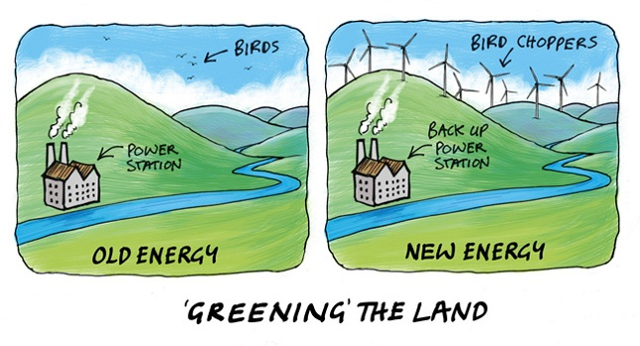

Slide 14
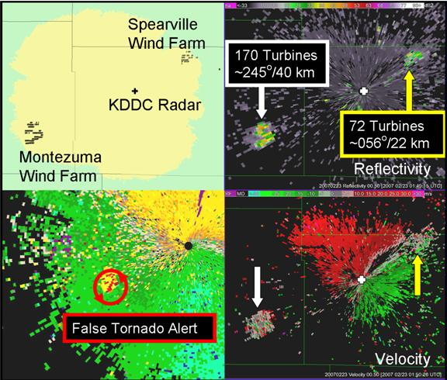
Wind Farms Affect Radar
The NWS office in Burlington, Vermont has shown how wind farms provide clutter the can trigger alarms that forces the FAA to delay or reroute planes. NOAA has an FAQ on this issue. This confusion causes expensive aircraft re-routing and excess fuel consumption. Boston Center in Nashua could be affected.

Slide 15
Improper Maintenance And Safety Issues
In Florida, the Desert Valley Star reported in January 2009 that FPL/NER operates 60 wind turbines—and reportedly 40% were “malfunctioning, in disrepair, or need of maintenance.”
Windtech International after a survey of 75 wind farm operators in the U.S. in 2008 found that 60% of turbines may be behind in critical maintenance
Palm Springs keeps turbines more than ½ mile from highways and residences because of the risk of flying broken blade debris from poorly maintained wind farms.
Renewables UK, an industry trade association, has admitted to 1,500 wind turbine accidents/incidents in the UK alone during the past five years, the London Telegraph reported. Those included 300 injuries and four deaths.

Slide 16
Wind is Expensive
A Heritage study found that swapping one megawatt-hour (MWh) of electricity from coal or natural gas combined-cycle generation to wind drives the cost up from about $79 to $177 per MWh. Offshore wind is worse at $218 per MWh.
Heritage analyzed a generic Renewable Energy Standard that starts at 3 percent of total power generation in 2012 and rises by 1.5 percent per year. They found it would destroy 1 million jobs by 2020, when the standard reaches 15 percent. The average family would pay $2,400 more per year.
Germany and some other nations have aggressively pursued renewable energy, and they are paying a big price for it. Consumer electricity prices in Germany are approximately three times as high as prices in the United States, and wind constitutes only about 8.9 percent of Germany’s electricity generation.
In the United States, green energy policies affect the poorest households three times more than the richest households.

Slide 17
Wind is bad for the economy
In Spain, 2.2 jobs were lost for every green job created and only 1 of 10 green job was permanent. In Italy 3.4 jobs were lost for every temporary green job, Spain ceased subsidization, but the damage had been done. Industry relocated and unemployment reached 27.5%
In the UK 12 million people are said to be in energy poverty. Many pensioners have had to choose between heating and eating. Former UK Prime Minister David Cameron has publicly promised to ‘roll back’ green taxes -“We’ve got to get rid of all this green crap.” 280,000 have died from cold and 10,000 from heat.
Even in rock-solid Germany, up to 15% of the populace is now believed to be in “fuel poverty.” Some 300,000 low-income Germans were cut off by their power companies. As a result, Germany is building 24 coal fired plants and reinstating some nuclear to provide the back up to the underperforming wind and solar. Blackouts and brownouts are an increased occurrence. Now Germany is working with Russia on a natural gas pipeline to keep the lights on.

Slide 18
Spain was an early adopter (and an early rejecter) of large scale renewable generation

Slide 19
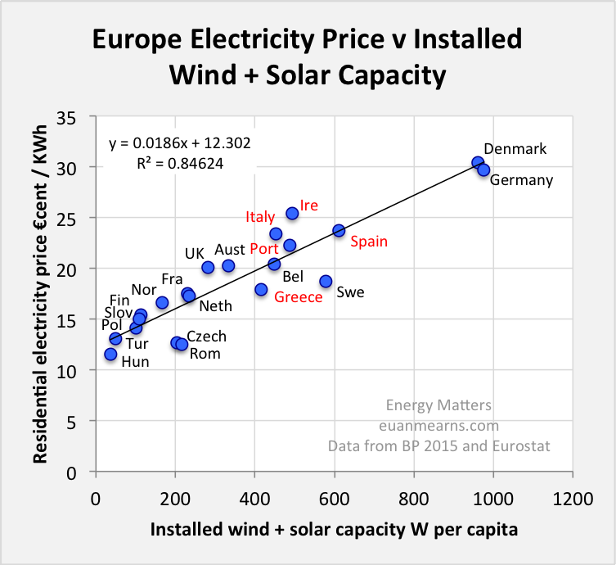

Slide 20
Bad science leads to bad policy
Bad policy hurts good people

